Slide 1
Pontoon Distributed System
Simple Distributed Application

Slide 2
Table of Content
Speaker
SpeakingStrategy
Messages
Dealers - Game Types
Human Player
Machine Player
Statistics
Multi Player
Statistics

Slide 3
Speaker -
A speaker listens to players(clients)
A speaker replies to players.
What a speaker speaks is the message pushed to the client/player.
A Speaker object is an object of a speaker class implemented by the Speaker interface.
In this game, a speaker = a dealer or a player

Slide 4
SpeakingStrategy
SpeakingStrategy is an interface
Is a property of a speaker
Determine the language(plain English, json, xml and etc.) the speaker speaks

Slide 5
Message
Message Type
Plain Messages
Json Messages
Implemented by SpeakingStrategy
This is extendable, XML, SOAP and etc.
Any player can use any type of message.
The dealer/server does not and does have to know the player type(machine or human).
Messages are used to convey information between the players and the dealers.

Slide 6
Message Order – Game Order
1. Game Type - A dealer is created
Duel
Melee
2. Message Type – The dealer’s SpeakingStrategy
Plain
Json
3. Start – The dealer gives 2 cards
4. Looping(twist or stick) – The dealer gives more cards
5. QUIT or START
QUIT – end game
START – go to step 4.

Slide 7
Dealers - Game Types
How many game types we have, how many dealers we have.
A dealer is an instance of a dealer class implemented by the dealer interface.
Duel – Single Player
The player(machine or human) plays against the dealer
DuelDealer
Melee – Multi-players
Players play with each other
At least 2 players
MeleeDealer
More? This is extendable.

Slide 8
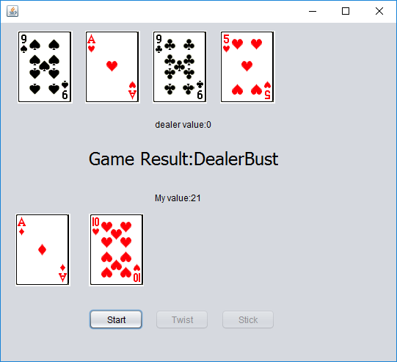
Human Player

Slide 9
Demo
Modify config.txt in server side
Run Server:
java -jar PontoonJavaApplication.jar
Modify config.txt in client side
Run Client:
Java –cp PontoonJavaApplication.jar pontoon.gui. GameWindow

Slide 10
Machine Player
The machine player is pre-programmed.
The message rules are the same.
Dealer(Server) has no idea.

Slide 11
Demo
Modify config.txt in server side
Run Server:
java -jar PontoonJavaApplication.jar
Modify config.txt in client side
Run Client:
Java –cp PontoonJavaApplication.jar machineDuelPlayer.MachineDuelPlayer

Slide 12
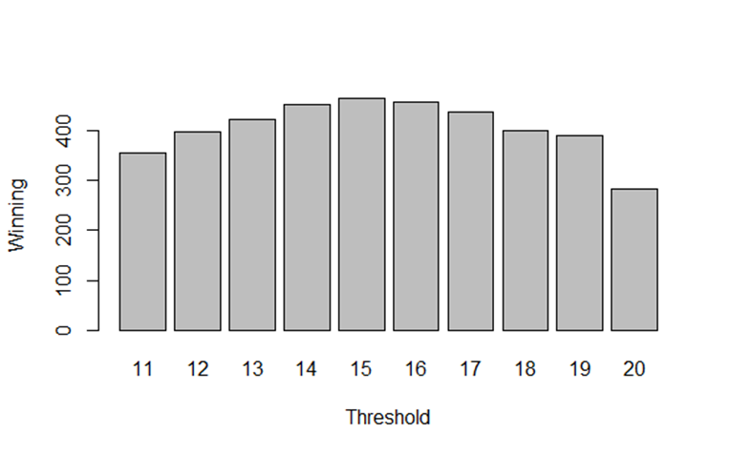
Duel Strategy

Slide 13
Multi-Players
Machine and Human players mixed
The dealer(server) only sends and receives messages and does not care the type of the player(Human or machine).
Player vs Player
Choose melee, choose two players.
Multi-Player game
Start a melee game.

Slide 14
Demo
Modify config.txt in server side
Run Server:
Java –cp PontoonJavaApplication.jar pontoon.multiplayer.MultiplayerServer
Modify config.txt in client side
Run Client:
Java –cp PontoonJavaApplication.jar pontoon.MultiPlayerGenerator.PlayerGenerator

Slide 15
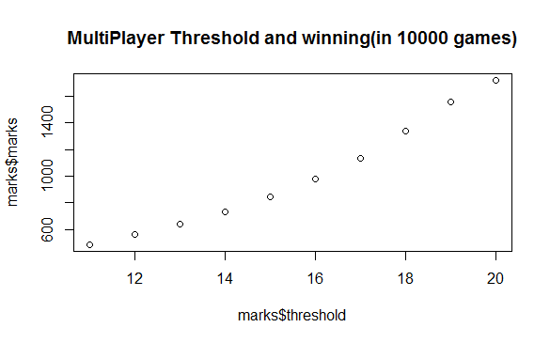
Multi Player Strategy

